Slide 1
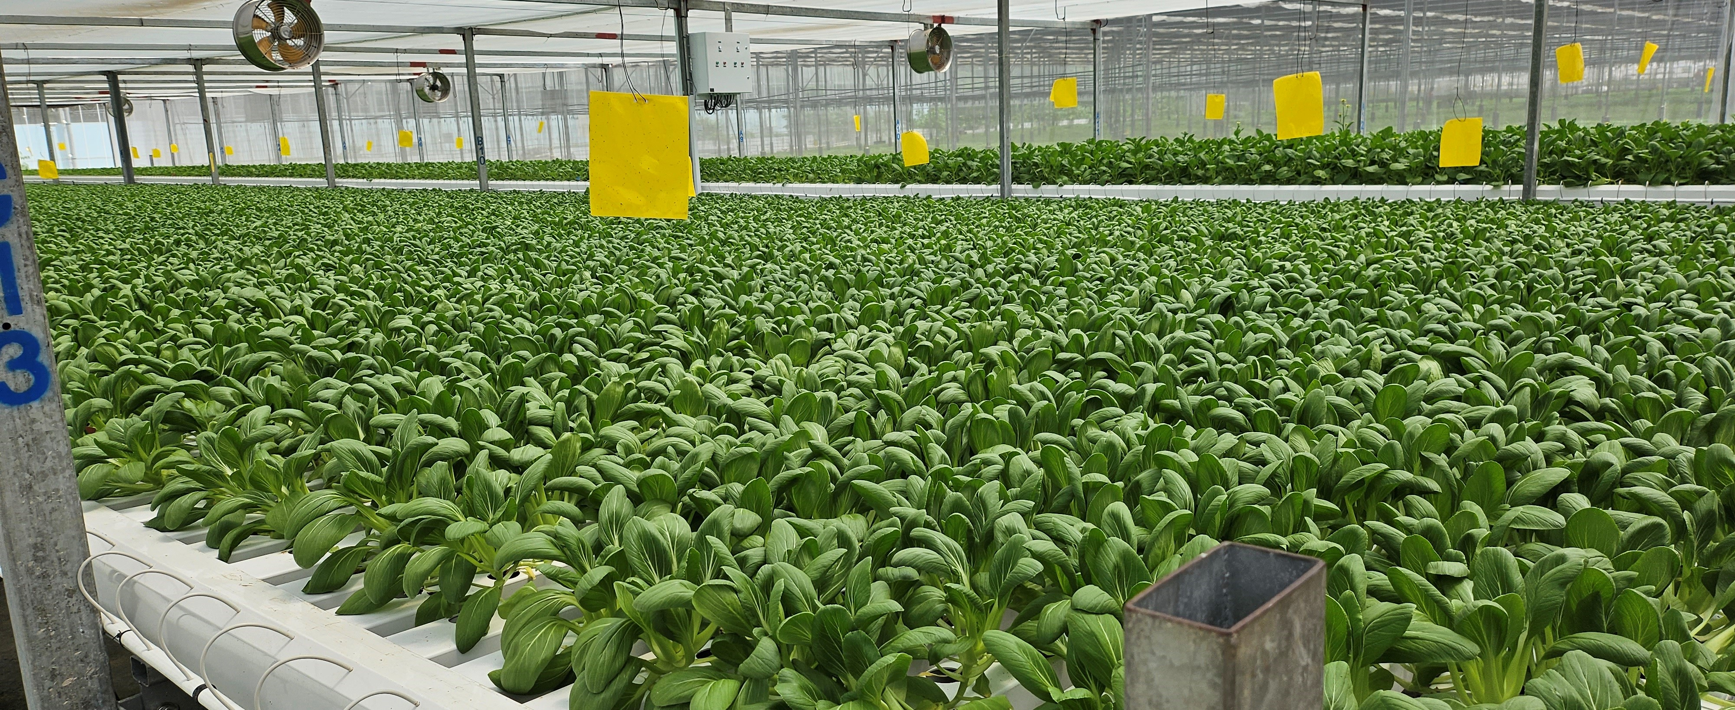
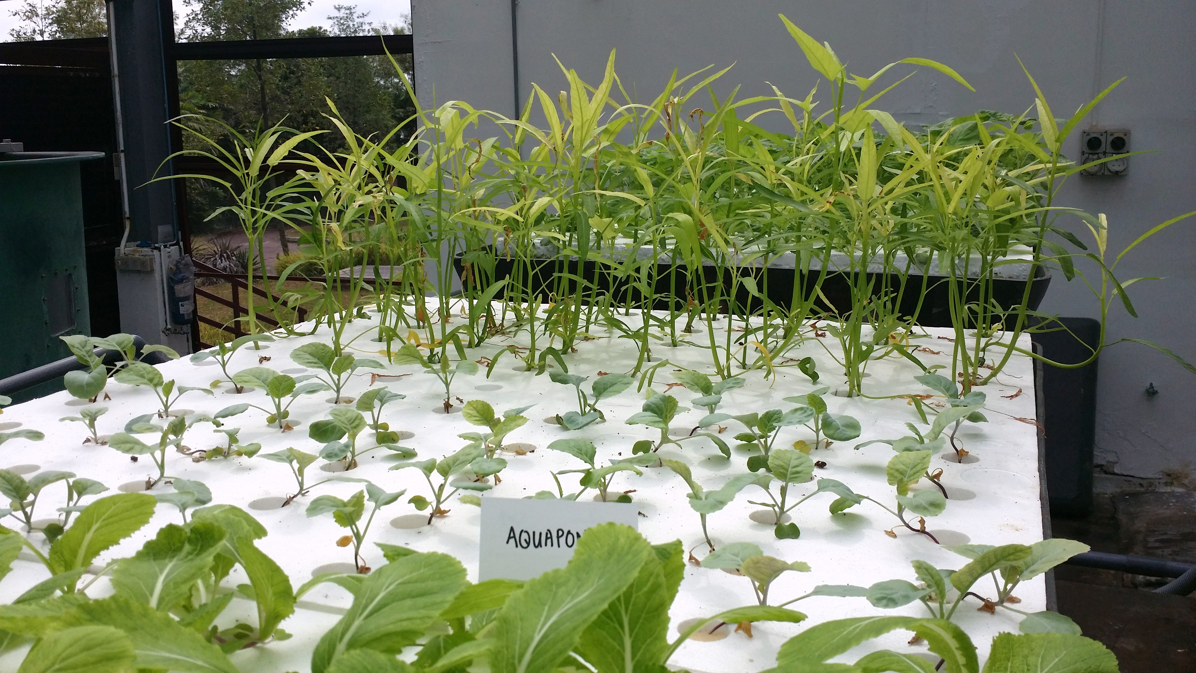
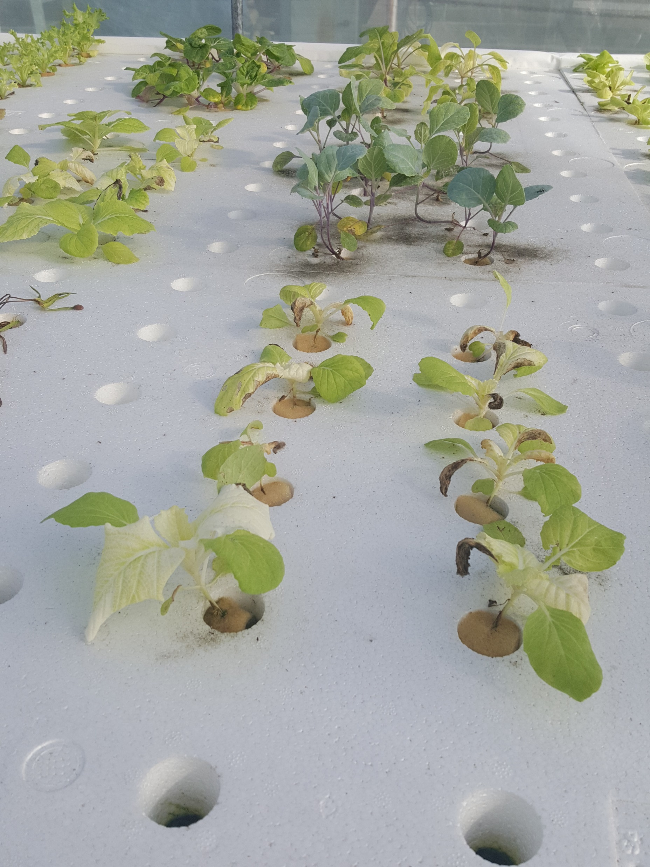
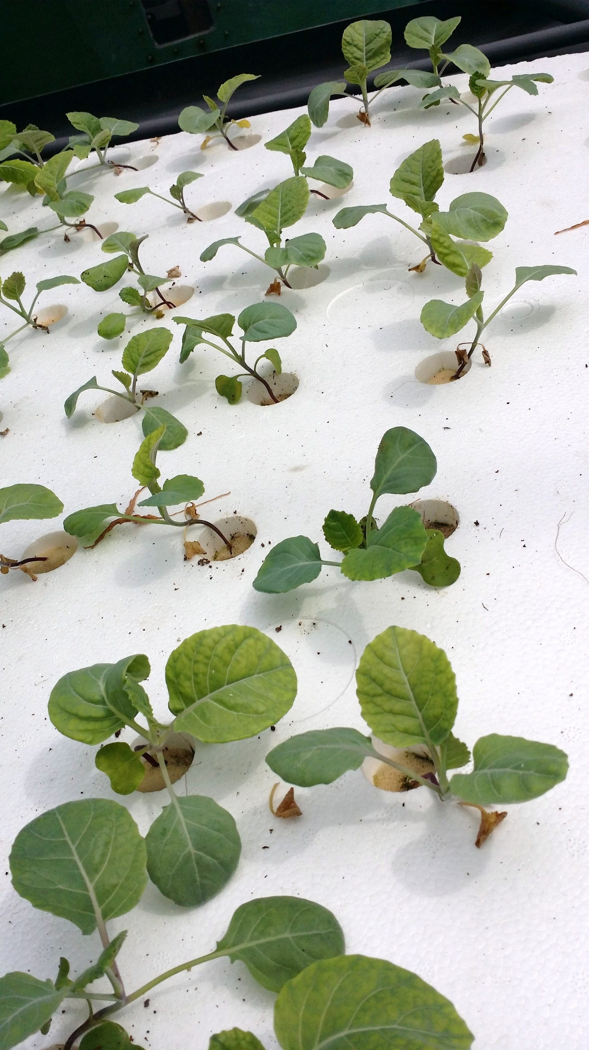
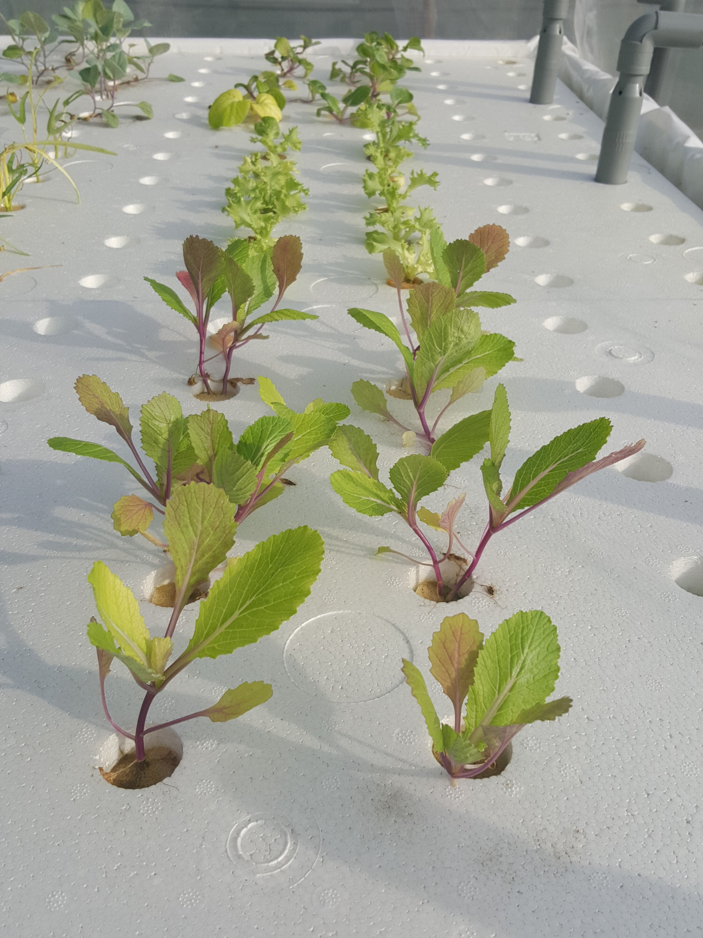
Plant Nutrient Management For Hydroponic Cultivation
Introduction to Hydroponic for Asian Leafy Greens
Getting your plant nutrients right is the foundation of successful hydroponic farming. Hydroponic plants rely on the nutrient solution provided for all the nutrient needs, making precise nutrient management essential for healthy plant growth and development. This guide will walk through the fundamentals of nutrient management, from understanding the basics to identifying deficiencies. With proper monitoring and timely adjustments, you will be able to maintain optimal plant health, improve yields.
Understanding Plant Nutrition Basics
Plants need nutrients to grow properly. These nutrients work together to support growth, maintain plant health, and strengthen natural defenses against pests and diseases. The right fertiliser mix delivers these essential nutrients in balanced amounts that plants can use.
Two key measurements help manage nutrients effectively EC (electrical conductivity) measures the nutrient concentration in your solution, whilst pH (potential of hydrogen) indicates the acidity level that affects nutrient uptake throughout the growing cycle.
Regular lab nutrient analysis helps identify nutrient deficiencies and maintain proper EC and pH levels, ensuring essential plant requirements plant.
Table 1. List of essential nutrients and their functions
Healthy plant growth through effective fertiliser management
Macro nutrients | Functions | * Optimal Range (ppm) |  | Micro nutrients | Functions | * Optimal Range (ppm)
Nitrogen (N) | Formation of proteins and amino acids. Essential for vegetative growth. | 150-200 |  | Iron (Fe) | Essential for chlorophyll formation and efficient photosynthesis. | 1-5
Phosphorus (P) | Energy from sunlight (ATP) used to transfer important in development of root system. | 25-50 |  | Copper (Cu) | Supports enzyme function and plant metabolism, helping plants produce energy and protect cells from damage. | 0.02-0.2
Potassium (K) | Regulates water uptake and transport. Essential for flower and fruit development. | 150-200 |  | Manganese (Mn) | Activate enzymes that break down nutrients and produce energy for plant growth. | 0.5-2
Calcium (Ca) | Strengthens cell walls and supports strong plant structure. | 100-150 |  | Zinc (Zn) | Essential for plant hormones that regulate growth and development. | 0.05-0.5
Magnesium (Mg) | Essential for chlorophyll production and healthy green leaf development. | 25-50 |  | Boron (B) | Works with calcium to strengthen cell walls and help plants use calcium more effectively. | 0.1-1
Sulphur (S) | Important for protein synthesis, enzyme activity, and disease resistance. | 25-75 |  | Chlorine (Cl) | Maintains electrical balance with other nutrients in plant cells for proper function. | 1-5
* ppm means "parts per million" - a unit for measuring very small concentrations.
Visual Signs of Nutrient Deficiencies in Asian Leafy Greens
Plants show clear warning signs when they lack proper nutrients. Patterns of yellowing leaves inform you which nutrients are deficient. New leaves might stay small and misshapen instead of growing normally. Watch for yellowing between the leaf veins or along leaf edges. Poor nutrient levels also affect the whole plant structure, leading to weak stems and poor root growth. The examples below show common nutrient deficiency signs in Asian leafy greens, and the next section will help you identify which nutrients are lacking based on these visual symptoms. Asian leafy greens are particularly susceptible to iron deficiency, which commonly appears as leaf yellowing and turning white in severe deficiency.
Kangkong
Upper Leaves are pale
Sparse foliage
Spindly growth
Amaranthus
Leaves are pale
Stunted growth
Leaf tip necrosis
Gailan
Leaves are yellowing
Stunted growth
Discoloration in mature leaves
Leaf Mustard
Narrow Leaves
Purplish stem and leaf vein
Stunted growth
Page 1
Sep 2025

Slide 2
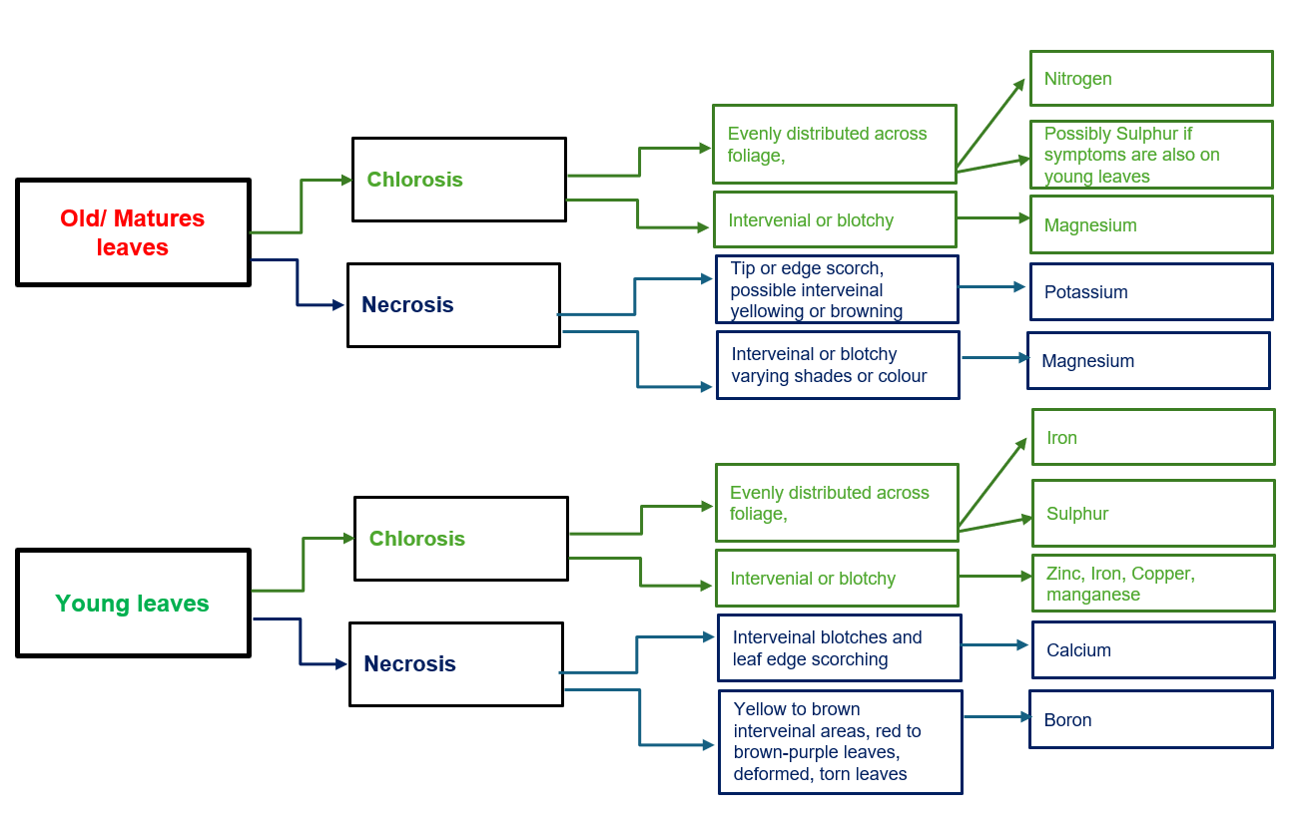
Plant Nutrient Management For Hydroponic Cultivation
Identifying Nutrient Deficiency Symptoms
Plants can develop problems from various causes that often look similar at first glance. Finding the right solution depends on correctly identifying whether the problem comes from living organisms (biotic) or non-living factors (abiotic) like nutrient deficiencies.
Signs of Living Organisms (Biotic):
Insects leave visible traces like webbing, eggs, or cocoons
Fungi appear as fuzzy growth or powdery coating
Bacterial damage shows up as slimy or water-soaked areas
Signs of Non-Living Causes (Abiotic):
Whole plant appears unhealthy
Overall stunted growth
Yellowing leaves
Bronze or brown discolouration
Use the diagnostic flow chart (Figure 1) to help identify nutrient deficiency symptoms in your plants.
Figure 1. Flow chart to identifying nutrient deficiencies
Older/Matures leaves are fully expanded with a darker green colour and thicker, more rigid texture compared to young leaves
Nutrient Deficiency Symptoms in Hydroponics
Choy-sum after 30 days
Nitrogen
Phosphorous
Potassium
Calcium
Magnesium
General yellowing of older leaves at bottom of plants
Stunted and smaller leaves than normal
Purple colouration along leaf stem and midrib
Severe leaf discolouration
Stunted growth
Older leaves turning dark green or reddish purple-vein
Older leaves wilting
Scorching inward from the leaf margin
Interveinal chlorosis
Severe leaf discolouration
Often progressive, starting with lighter green before full colour loss
Leaves appear distinctly yellow, white, or pale cream coloured
Mild leaf discolouration
Often progressive, starting with lighter green before full colour loss
Plant able to grow, absence of stunted growth
Amaranthus after 25 days
Nitrogen
Phosphorous
Potassium
Calcium
Magnesium
Severe leaves discolouration
Often progressive, starting with lighter green before full colour loss
Leaves appear distinctly yellow, white, or pale cream-coloured
Leaves discolouration
Stunted growth
Leaves appear distinctly yellow
Chlorosis, showing green midrib of leaves surrounding yellowing leaf tissue
Stunted growth
Resilience to keep growing
Plants tolerates deficient condition
Distinct interveinal chlorosis of older leaves
Yellowing between veins beginning on old leaves
Necrotic and cupping of leaves.
Page 2
Sep 2025

Slide 3
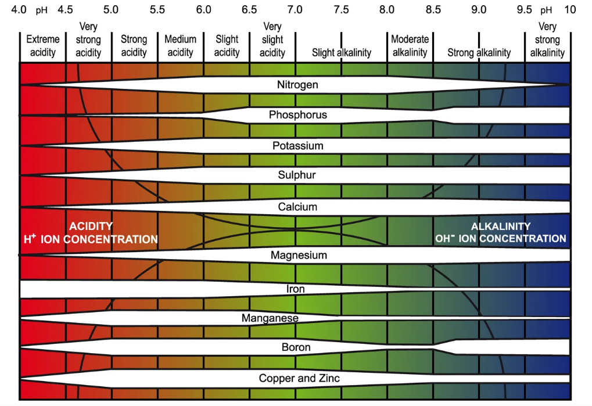
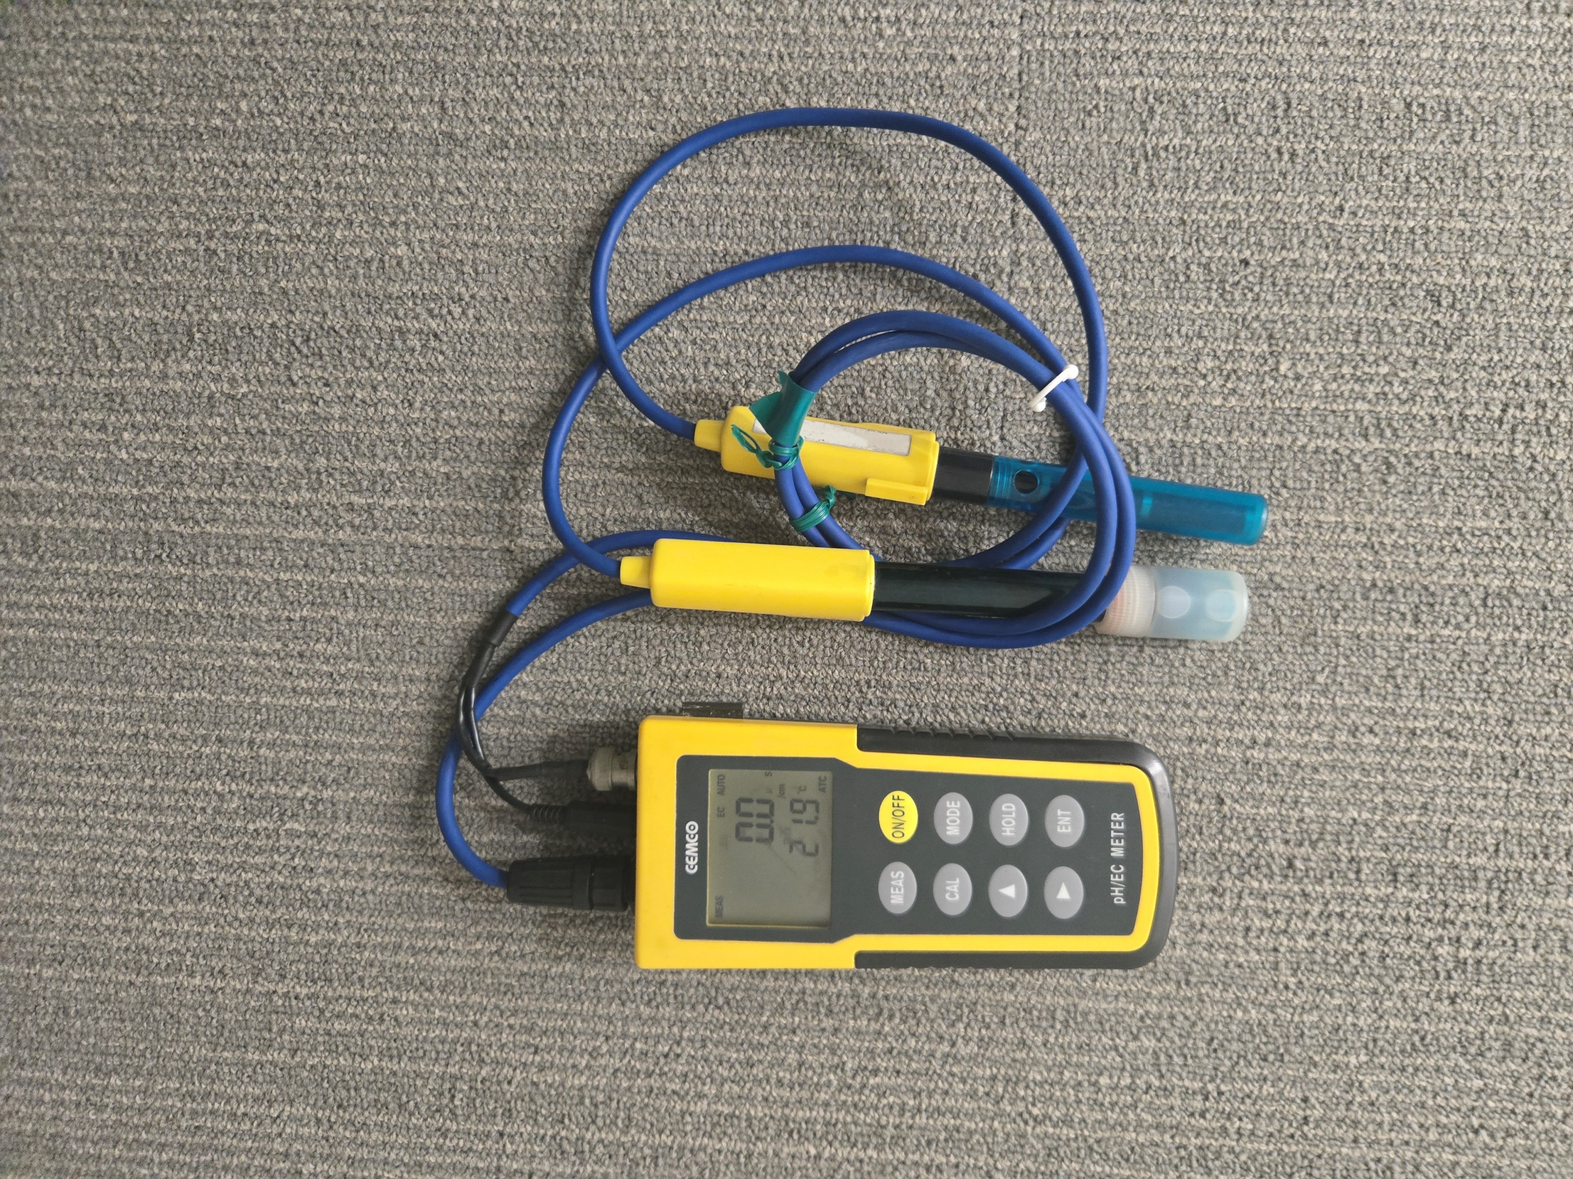
Plant Nutrient Management For Hydroponic Cultivation
pH and EC Management for Asian Leafy Greens
For Asian leafy greens, maintaining the correct EC and pH is essential for nutrient uptake and healthy growth. Even with proper fertilisation and correct EC, your leafy greens may show deficiency symptoms if pH levels drift outside the optimal range. In general, these crops perform best in the slightly acidic range ie pH 5.5- 6.5. (Table 2).
Check pH levels daily, especially during periods of rapid growth when plants take up nutrients quickly.
If your leafy greens show nutrient deficiency signs despite regular fertilisation, check your pH levels first before adjusting your nutrient formula.
The pH table indicates which nutrients plants can uptake at different pH levels- Source: www.pda.org.uk/impact-of-ph-on-nutrient-availability/.
Table 2. Recommended EC and pH Ranges for Asian Greens in Hydroponics
Type of Crops |  | EC (* mS/cm) | pH | Remark
Brassicas family | Bok choy (pak choi), choy sum, gai lan (Chinese broccoli), napa cabbage (wong bok), mizuna, komatsuna, tatsoi, Chinese cabbage, mustard greens (gai choy) | 2.0 - 2.5 | 5.5 - 6.8 | Generally, prefer moderate nutrient levels with slightly acidic conditions
Amaranth family | Chinese spinach (yin choy), red amaranth, green amaranth | 1.8 - 2.5 | 6.0 - 7.0 | Prefer higher nutrient concentrations and can tolerate neutral pH
Water-loving greens | Water spinach (kangkong), watercress | 1.5 - 2.0 | 5.5 - 6.5 | Moderate nutrient needs with preference for slightly acidic condition
* mS/cm stands for millisiemens per centimetre, measures how much nutrients are dissolved in your water.
pH and EC Measurement Procedures
pH Measurement
Calibrate your pH meter with standard buffer solutions (pH 4, 7, or 10) before use.
Rinse the electrode with distilled water between measurements to prevent cross-contamination.
Immerse the electrode fully in your nutrient solution and wait for the reading to stabilise before recording.
After each measurement, rinse the electrode with distilled water and store properly to maintain accuracy.
EC Measurement
Calibrate your EC meter with standard potassium chloride (KCl) solution (1.41 mS/cm) before use.
Immerse the probe fully in your nutrient solution.
Gently stir the solution and wait for the reading to stabilise before recording.
Record the measurement and clean the probe with distilled water after each use.
Maintenance Tips
Calibrate your meters regularly with buffer solutions to ensure accuracy—typically every few weeks or before critical measurements. Store electrodes in appropriate storage solution when not in use and replace them when readings become unstable or drift consistently.
Page 3
Sep 2025

Slide 4


Plant Nutrient Management For Hydroponic Cultivation
Best Practices for Nutrient Management
Regular monitoring helps ensure optimal plant growth by maintaining proper nutrient levels and growing conditions. Replenish fertiliser tanks with fresh water to compensate for evaporation, which concentrates nutrients and can lead to salt buildup. Check electrical conductivity (EC) and pH levels daily to track nutrient strength and acidity levels in your system. Use properly calibrated meters for accurate readings, following the measurement procedures outlined earlier in this guide. This routine monitoring allows you to make timely adjustments before nutrient imbalances affect plant health and productivity.
Keep detailed records of daily measurements and make gradual adjustments rather than large corrections when levels drift outside target ranges. Replace the entire nutrient solution periodically to prevent nutrient imbalances and maintain optimal growing conditions.
By implementing these practices consistently, you will create a stable growing environment that supports healthy plant development and maximises your crop yields whilst minimising waste and input costs.
Regular Monitoring
Fertiliser Management
Solution Management
Check pH levels daily and maintain between 5.5-6.5 for optimal nutrient uptake
Monitor EC readings daily to keep levels between 1.5-2.5 mS/cm
Calibrate pH and EC meters regularly according to manufacturer specifications
Proper fertiliser storage area in shaded area
Monitoring and documenting expiry dates before use
Application rate (amount to apply) specified on the label
Replenish nutrient solution if needed to ensuring optimal nutrient ratio due to intensive crop cycles
Adjust EC levels when adding fresh solution to maintain optimal concentration
Analyse nutrient solution weekly to monitor nutrient balance and system health
Local farms can tap on the Agri-Cluster Transformation (ACT) Fund with the enhanced Energy Efficiency Programme (EEP) to build capabilities and capacities that drive higher productivity in a sustainable and resource-efficient manner. Farms can tap on co-funding under the EEP to undergo an energy efficiency audit which will establish their baseline energy consumption and identify potential areas for improvements. Farms can also leverage the enhanced Capability Upgrading component to adopt resource and energy-efficient equipment and technologies from SFA’s prequalified list. All licensed farms can apply for co-funding under the EEP.
Let us know your thoughts
About the Author
Mohd Suhaime, knowledgeable in hydroponic farming with over four decades of expertise, is a member of the Agri-Technology and Food Innovation Department. His portfolio includes contributing to the "Singapore Urban Farming Project", a collaborative smart farming initiative, and implementing a Soilless Strawberry Cultivation project with Pokka Singapore. Additionally, Suhaime provides technical guidance to the local farming community.
Reference:
Kozai, T. (2018). Smart Plant Factory: The Next Generation Indoor Vertical Farms. Springer Nature https://doi.org/10.1007/978-981-13-1065-2.
Hashimi et al. (2023) A Review of Diagnostic techniques of visual symptoms of nutrients deficiencies in plant. A Review of Diagnostic techniques of visual symptoms of nutrients deficiencies in plant. International Journal of Agriculture and Research 6:2. https://www.ijojournals.com/index.php/ar/index
Viegas et al., (2018) Growth and visual symptoms nutrient deficiency in mangosteens (Garcinia mangostana L.) . American Journal of Plant Sciences 9: 1014-1028. https://www.scirp.org/pdf/ajps_2018041915291125.pdf
Page 4
Sep 2025

